Slide 1

Modern interdisciplinary SDI and spatial concepts as a platform for new curricula’s
Zlatko Srbinoski
Faculty of Civil Engineering,
University of Ss Cyril and Methodius
Zeljko Bacic, Vesna Posloncec Petric
Faculty of Geodesy
University of Zagreb

Slide 2

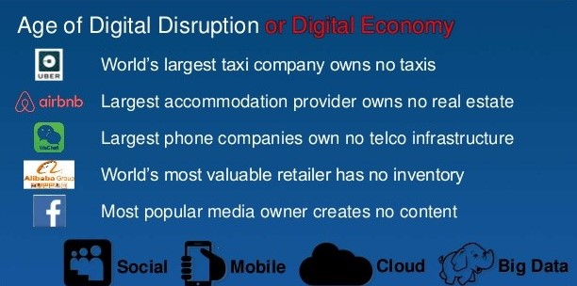
We live in disruptive World!
Disruptive change for people:
Turbulence, uncertainty a fact of life
„Life will never be the same again”
Positive as well as negative
Externally or internaly driven
Notes:
Istaknuti kako se nalazimo u svijetu stalne promjene koja je povezana s 4. digitalnom (industrijskom) revolucijom, koja nije samo tehnološka već i socijalna…

Slide 3
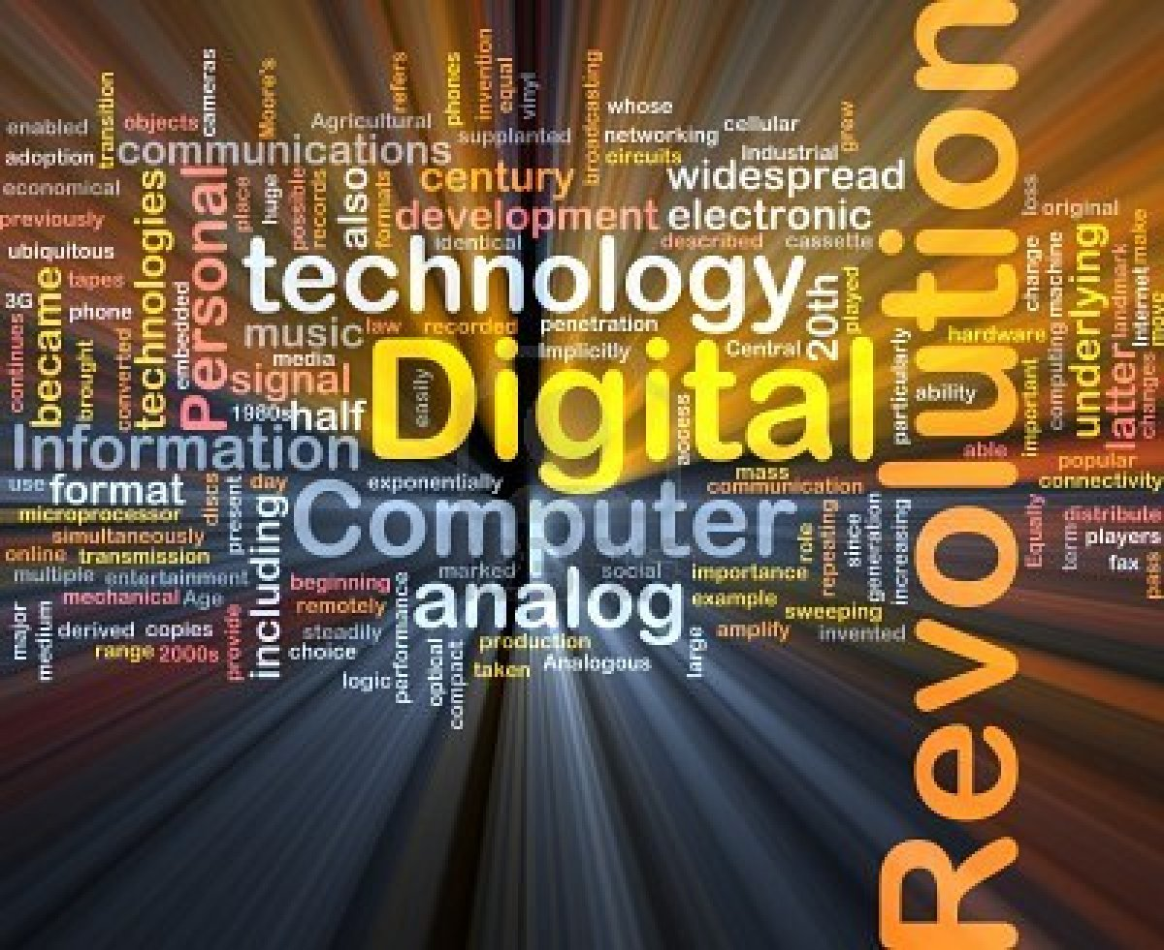
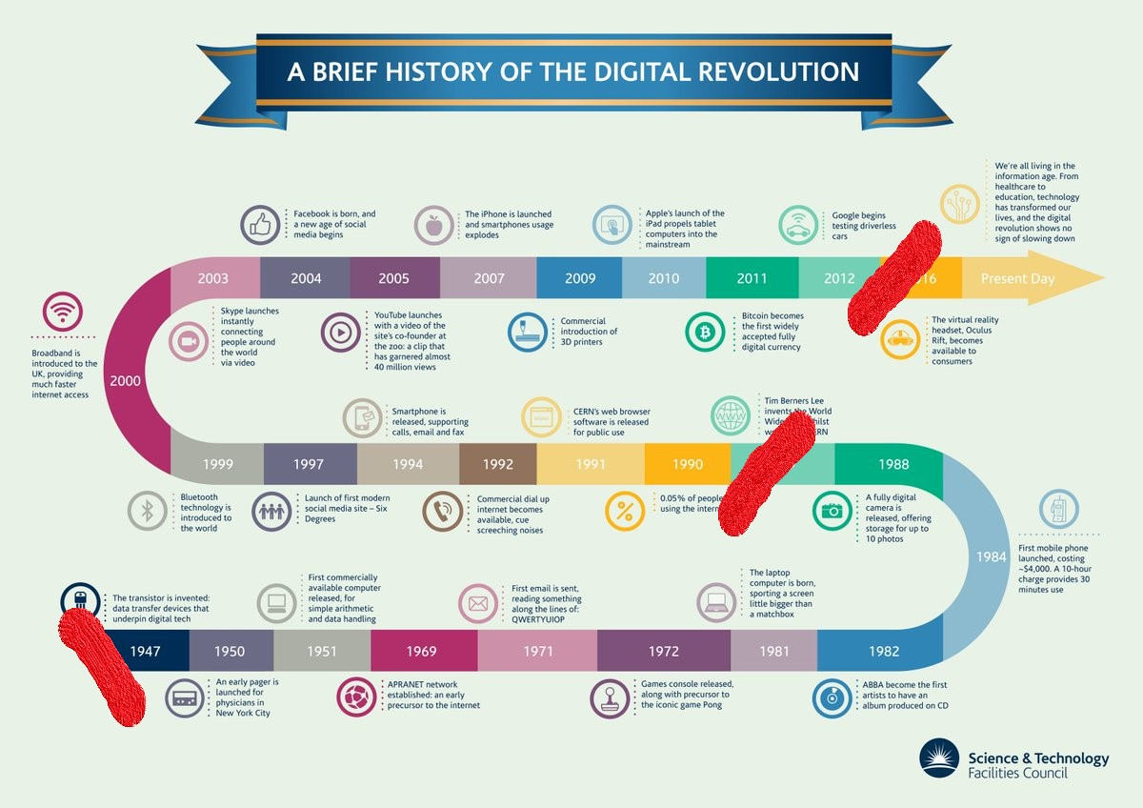
Digital revolution
Digital revolution is not about technology, its about human!
1st driver: social media
2nd driver: spatial data
Notes:
Kada već govorimo o digitalnoj revoluciji, što je ona i kada je počela?
Neki kažu 1947. s pojavom tranzistora, drugi 1990. s početkom primjene interneta, a treći tek pred koju godinu kada su nestale hardwerske zapreke razvoju ICT tehnologije
Kako god, pokretači digitalne revolucije su socijalni mediji i potreba za upravljanjem svim procesima u društvu zasnovanim na prostornim podacima

Slide 4

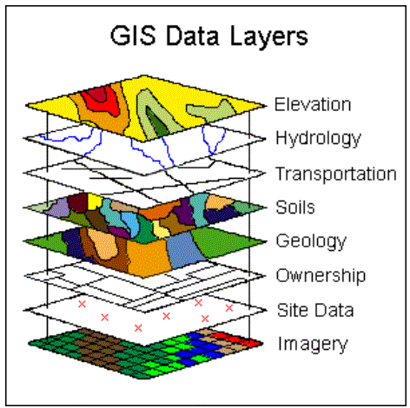
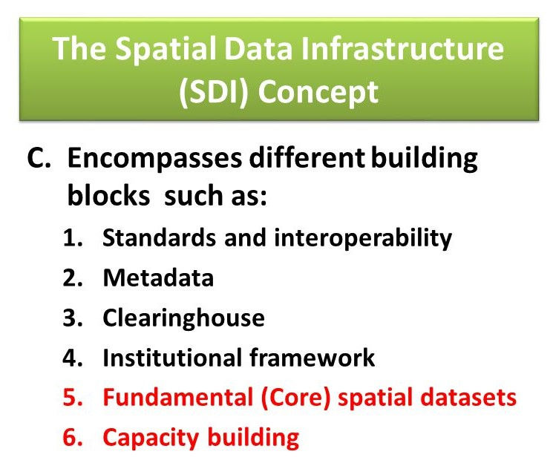
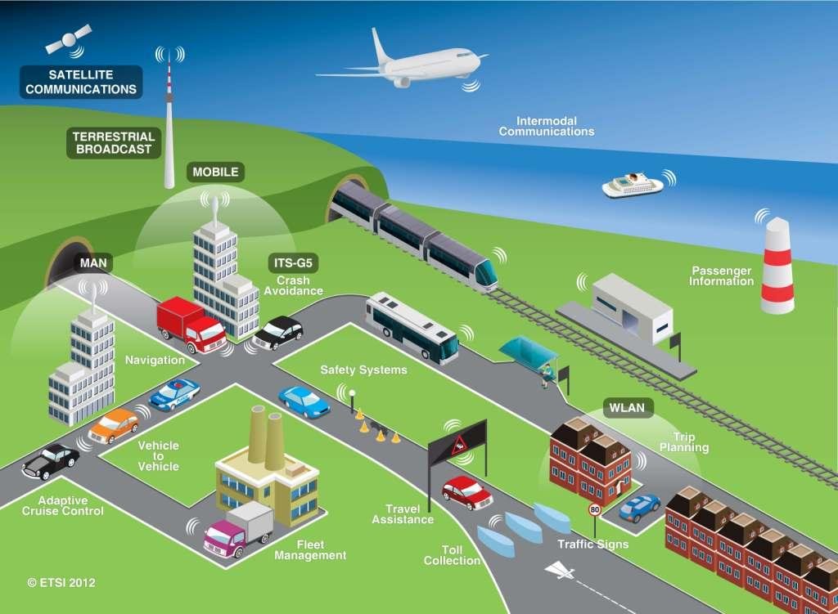
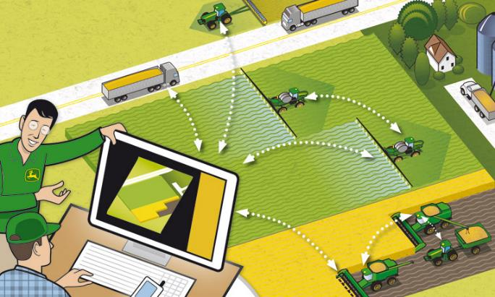

Spatial data based concepts
Smart environment
Precise farming
Intelligent transportation
Notes:
Socijalne medije ćemo prepustiti drugim strukama, a ako govorimo o prostornim podacima, osim neslućenog razvoja tehnologije senzora, razvijeni su i razvijaju se brojni koncepti korištenja prostornih podataka – od GIS-a, koji je prvo koncept a tek onda alat, preko Infrastrukture prostornih podataka do današnjih aplikativnih koncepata … pametni gradovi, ….

Slide 5
Digital disruption is more than just a technology shift, it’s new concepts and business models
„Changes enabled by digital technologies that occur at a pace and magnitude that disrupt established ways of value creation, social interactions, doing business and more generally our thinking”
(Riemer, 2013)
Meaning, it requires also new educational models!
Notes:
Stoga digitalna revolucija odnosno digitalni poremećaj nije samo pomak u tehnologiji već promjena shvaćanja, dakle promjena koncepata i modela poslovanja, što mora podrazumijevati i podrazumijeva i promjenu načina i sadržaja obrazovanja

Slide 6
A million dollar questions:
How should future education model look like?
What knowledge and skills are necessary for future?
How should teaching be organised?
Notes:
Sve navedno je dovelo do današnje situacije u kojoj imamo više pitanja no odgovora
Pitanja vezana za edukaciju, pogotovo akademsku i cjeloživotnu su: …

Slide 7
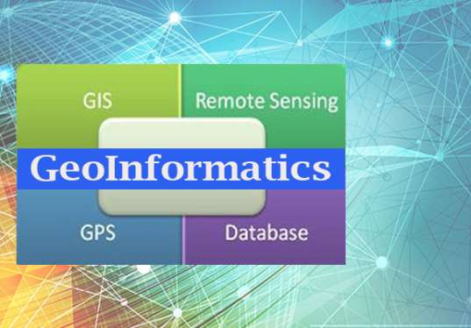
The educational profile of future (Enemark, 2009)
Notes:
Već 2009. godine Stig Enemark je sagledavajući kako bi trebao izgledati budući obrazovni profil novog tipa stručnjaka – geoinformatičara trebao biti definiran oko Spatial Information Management-a
Današnja razmišljanja i definicije opisuju Geoinformatiku slično …

Slide 8
Future professions and professionals
Jobs in future – how to define them when presently is forecasted that 65% of scholars which recently entered the primary schools will do the jobs which today do not exist
Even today we have issues with new jobs like
Social media manager
Machine learning engineer
Debt collector
Factoring specialist
Influencer
Youtuber
Teacher?
Notes:
Future of professions and knowledge-skill profile of new professionals is probably the greatest challenge for academic institutions today
Technology and respectively job profiles are developing much faster than ability of academic institutions to change their study programs
Može se komentirati navedene primjere poslova koji se u odnosu na formalni sustav obrazovanja razvijaju nekontrolirano

Slide 9
9 things that will shape the future of education (Henny, 2016)
Diverse time and place
Students will have more opportunities to learn at different times in different places.
Personalized learning
Students will learn with study tools that adapt to the capabilities of a student.
Free choice
Though every subject that is taught aims for the same destination, the road leading towards that destination can vary per student.
Project based
As careers are adapting to the future freelance economy, students of today will adapt to project based learning and working.
Notes:
Današnja razmišljanja koji će pokretači oblikovati način budućeg obrazovanja ukazuju da će u slijedećem razdoblju doći do velikih promjena u izvođenju nastave.
Par komentara na drajvere …
Navedenim pokretačima bi vjerojatno trebalo dodati i korištenje internetske tehnologije kroz Massive Open Online Courses – MOOC’s

Slide 10
9 things that will shape the future of education (Henny, 2016)
Field experience
Experience in ‘the field’ will be emphasized within courses. Schools will provide more opportunities for students to obtain real-world skills that are representative to their jobs.
Data interpretation
Computers will soon take care of every statistical analysis, and describe and analyze data and predict future trends. Therefore, the human interpretation of these data will become a much more important part of the future curricula.
Exams will change completely
As the factual knowledge of a student can be measured during their learning process, the application of their knowledge is best tested when they work on projects in the field.
Notes:
Današnja razmišljanja koji će pokretači oblikovati način budućeg obrazovanja ukazuju da će u slijedećem razdoblju doći do velikih promjena u izvođenju nastave.
Par komentara na drajvere …
Navedenim pokretačima bi vjerojatno trebalo dodati i korištenje internetske tehnologije kroz Massive Open Online Courses – MOOC’s

Slide 11
9 things that will shape the future of education (Henny, 2016)
Student ownership
Students will become more and more involved in forming their curricula
Mentoring will become more important
In the near future, students will incorporate so much independence in to their learning process, that mentoring will become fundamental to student success.
+
Using of Internet technologies trough Massive Open Online Courses – MOOC’s
Notes:
Današnja razmišljanja koji će pokretači oblikovati način budućeg obrazovanja ukazuju da će u slijedećem razdoblju doći do velikih promjena u izvođenju nastave.
Par komentara na drajvere …
Navedenim pokretačima bi vjerojatno trebalo dodati i korištenje internetske tehnologije kroz Massive Open Online Courses – MOOC’s

Slide 12
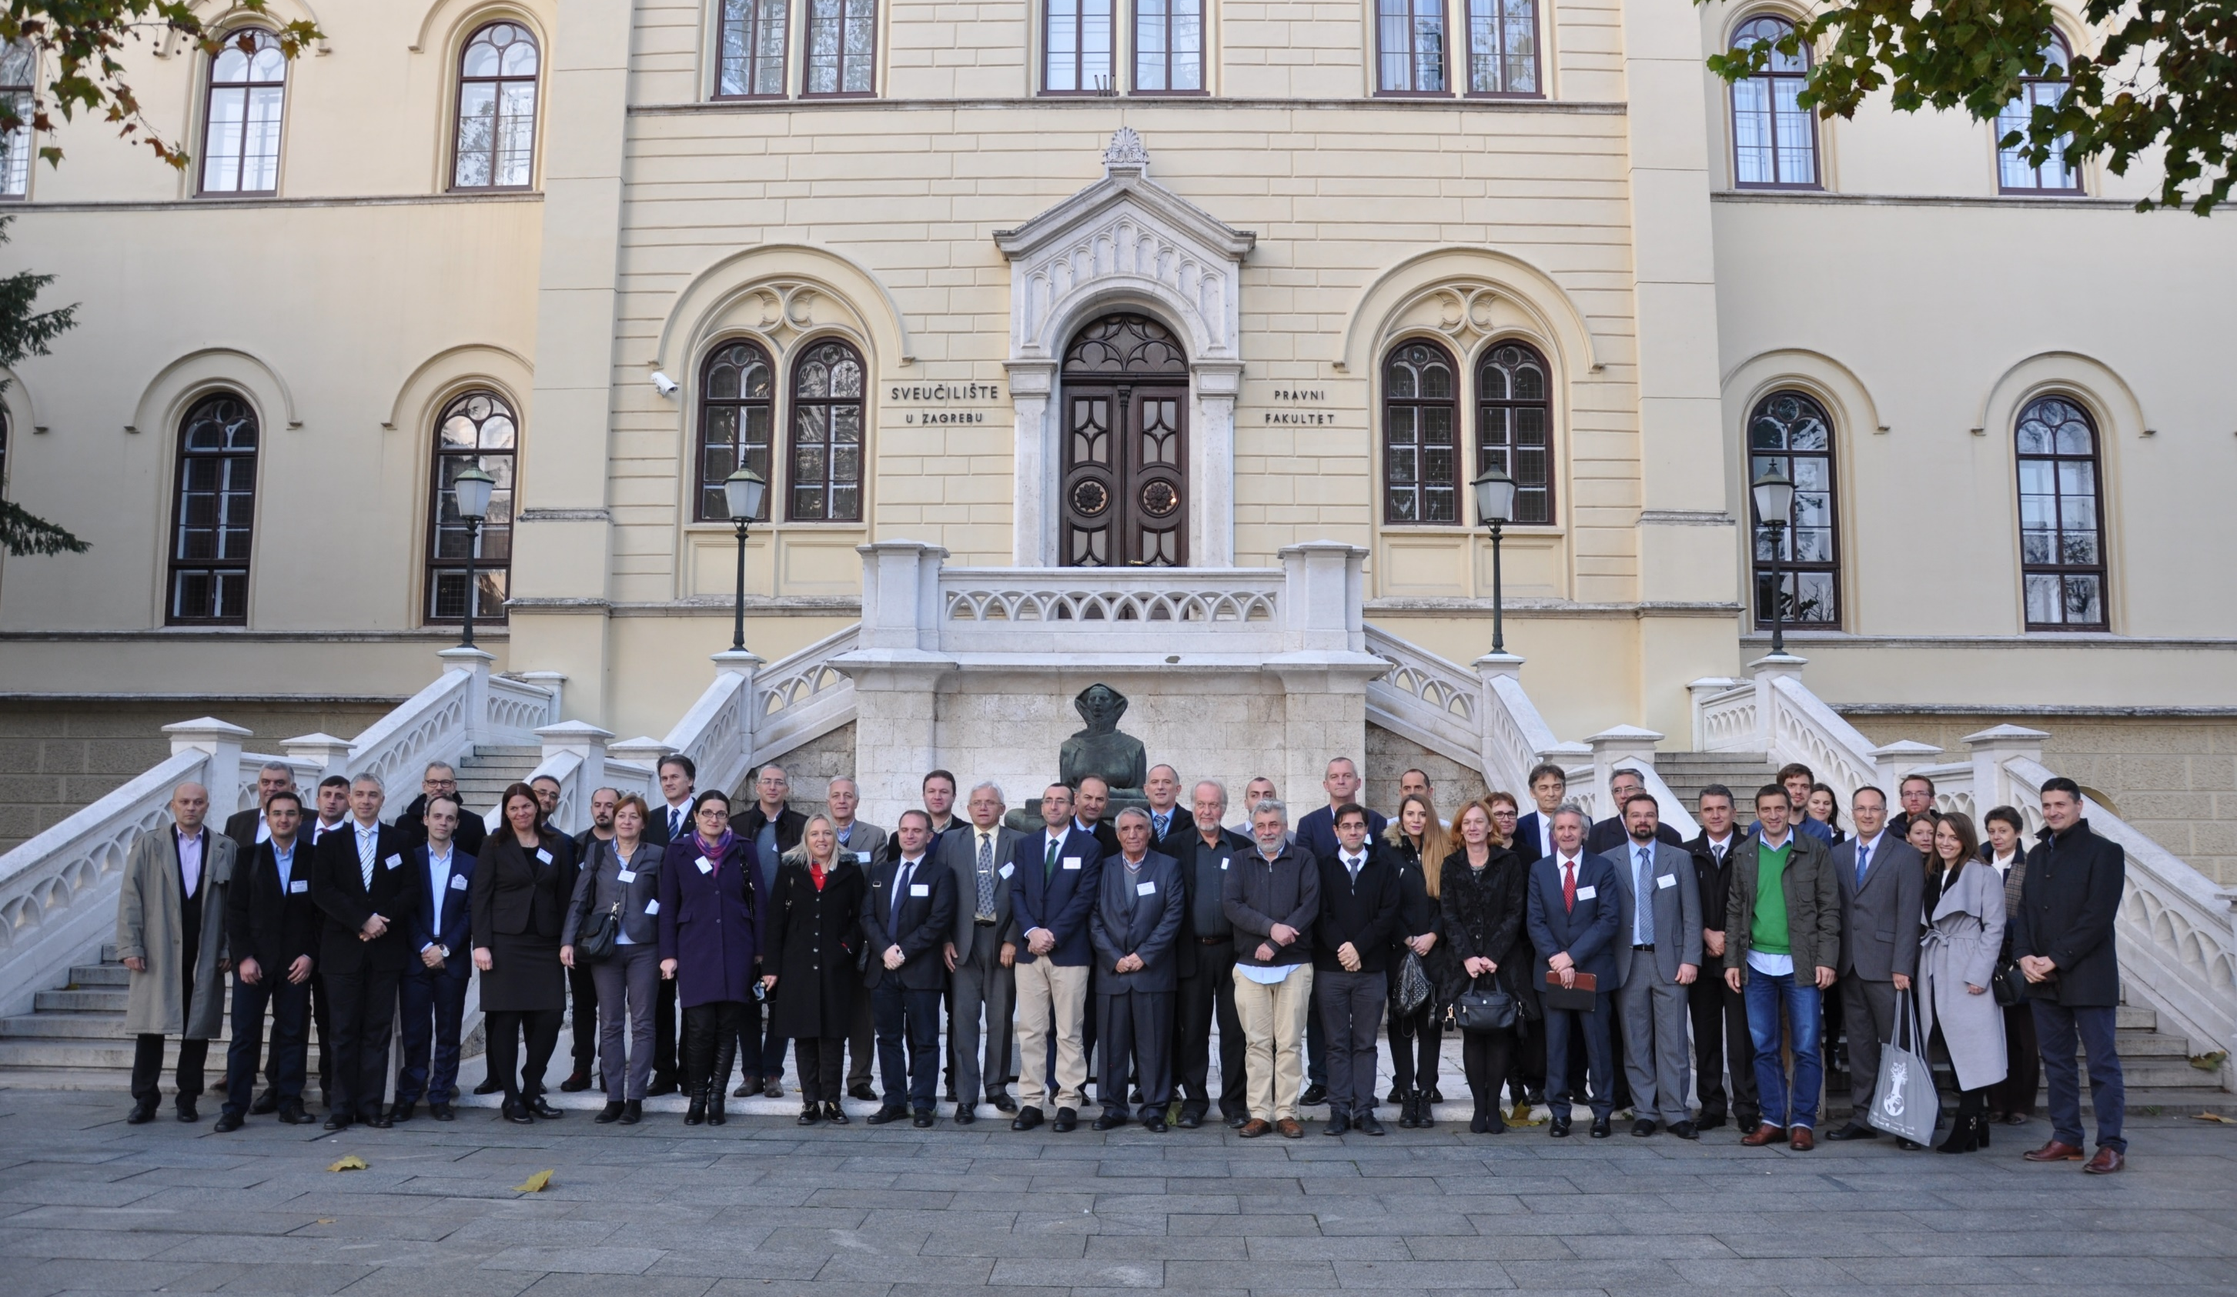
BESTSDI Contribution

Slide 13
BESTSDI Contribution
Recognize that many partners from different backgrounds have a common interest in the development and implementation of SDI:
Geodesy and Geoinformatics (UNIZG – FOG, UNIST, UKIM, PUT – FCE, UBL, UNS – FTS, UPZ)
Geology and mining (UNIZG - FGE, PUT – FGM, UNTZ);
Geography (UNMO, UCG – FF)
Civil Engineering (UNSA – FCE, UNS - FCE);
Agriculture (UNSA – FAFS, UCG – BF);
Forestry (UNBG)
Business and Economy (UBT).
Excellent SDI team from Belgium (KUL), Germany (HBO) and Sweden.

Slide 14
BESTSDI Contribution
SDI curricula have been developed:
INITIAL

Slide 15
BESTSDI Contribution
SDI curricula have been developed:
SPECIALIZED

Slide 16
BESTSDI Contribution
LLL courses have been developed – and EXECUTED

Slide 17
BESTSDI Contribution
Equipment for the promotion and development of SDI - PURCHASED
…

Slide 18
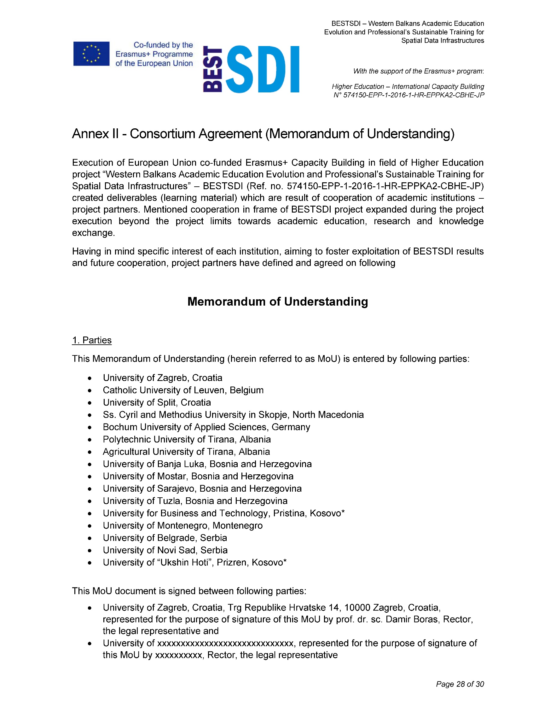
Conclusion – Beyond BESTSDI
Is it BESTSDI finished story?
GEOBIZ

Slide 19


Thank you for your attention!
www.bestsdi.eu
info@bestsdi.eu
----
This project has been funded with support from the European Commission. This publication [communication] reflects the views only of the author, and the Commission cannot be held responsible for any use which may be made of the information contained therein.

